Slide 1
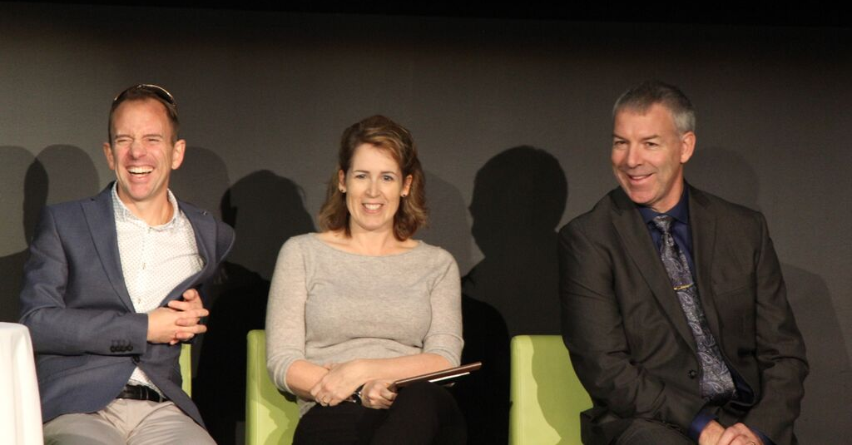
#MYRCA25

Slide 2
2015

Slide 3
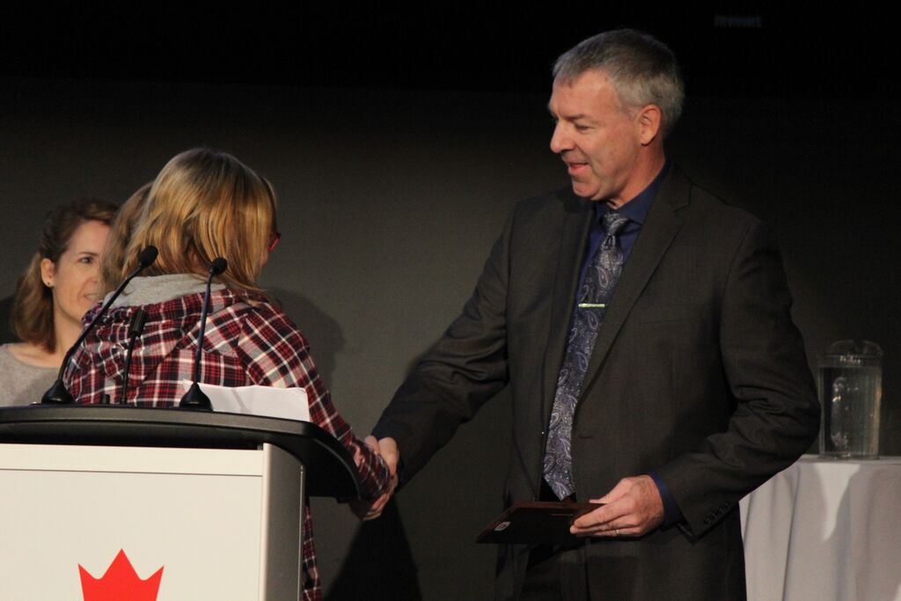
2015

Slide 4
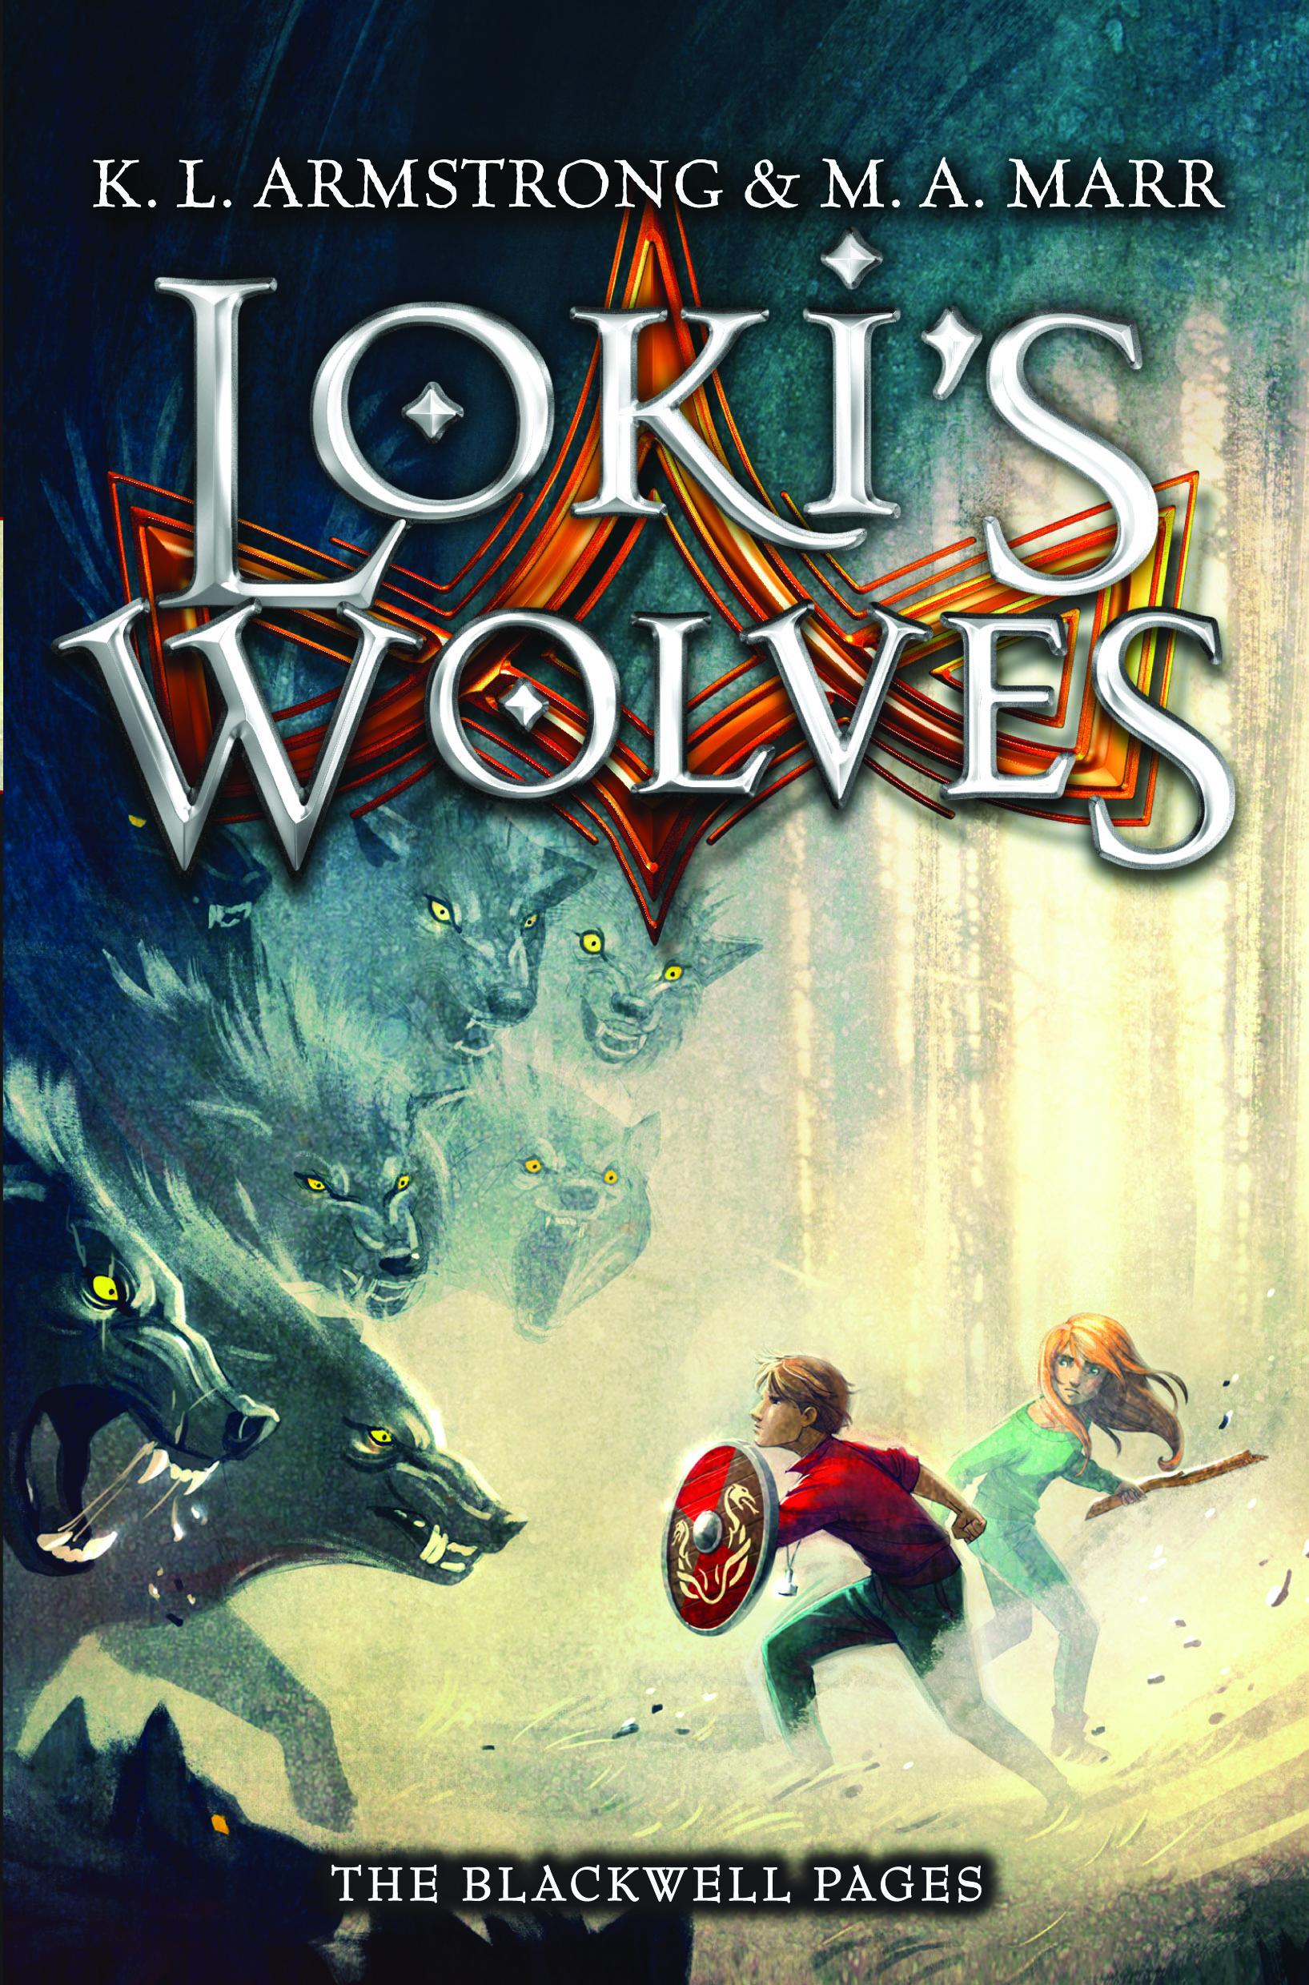
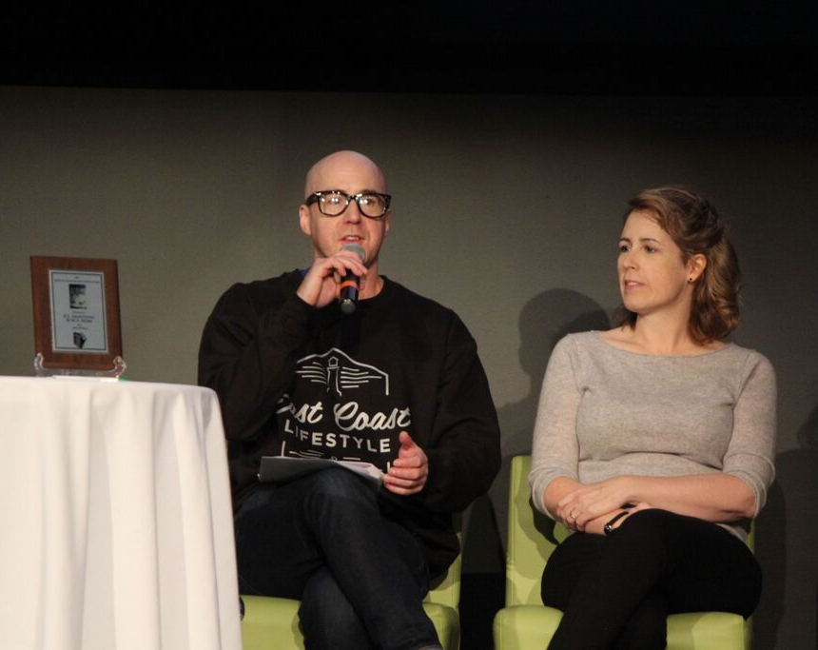
2015

Slide 5
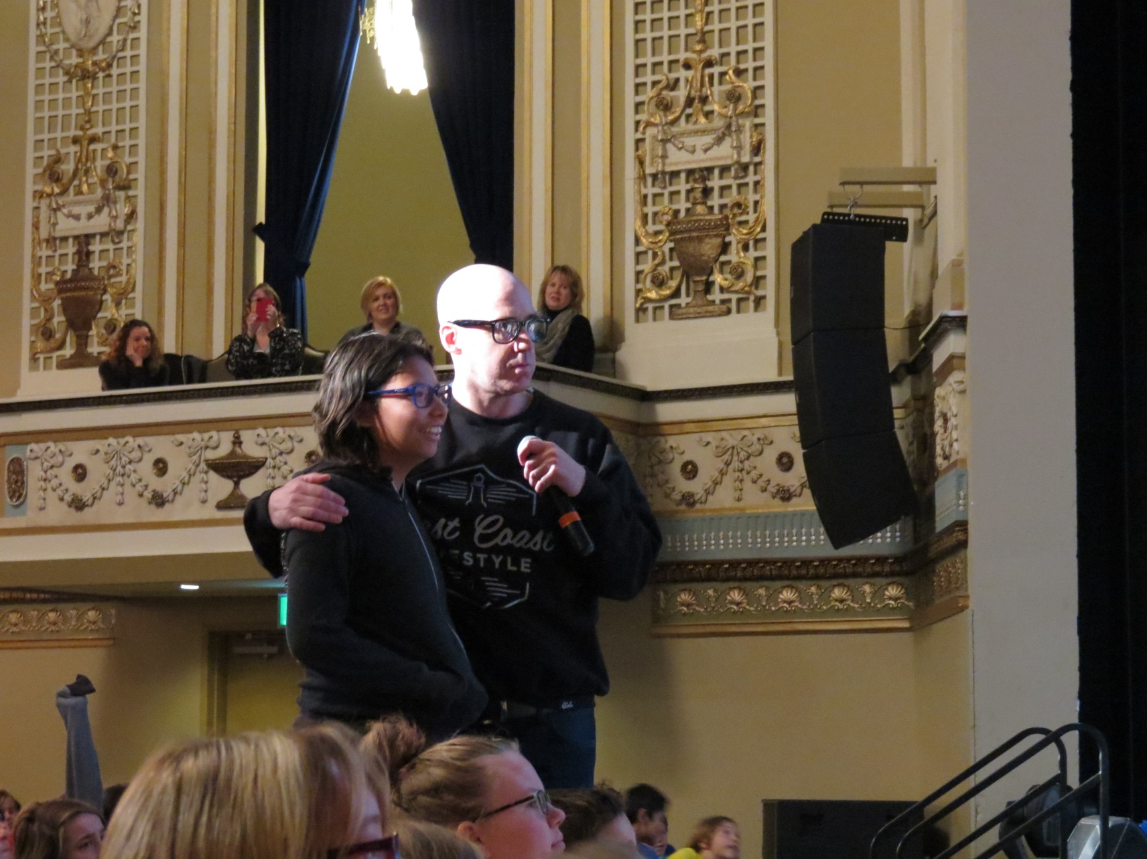
Q & A

Slide 6
www.myrca.ca
2016

Slide 7
The Manitoba Young Readers’ Choice Awards
promotes reading to students in grades 5 to 8
living in Manitoba
by giving them the chance to
VOTE for their favorite Canadian book
From a yearly list.
Read more = Vote more!
Read 3 = vote once
Read 6 = vote twice
Read 15 or more = vote three times!

Slide 8
Mystery
Treasure Hunt
Nate finds clues and a map in a cardboard box that leads him and his friend Simon on an adventure to find the missing “shipment #35 – Gold”! But when creepy Old Man Fortier finds out about it, they are in a race to get there first.
If you liked: Indiana Jones
2016

Slide 9
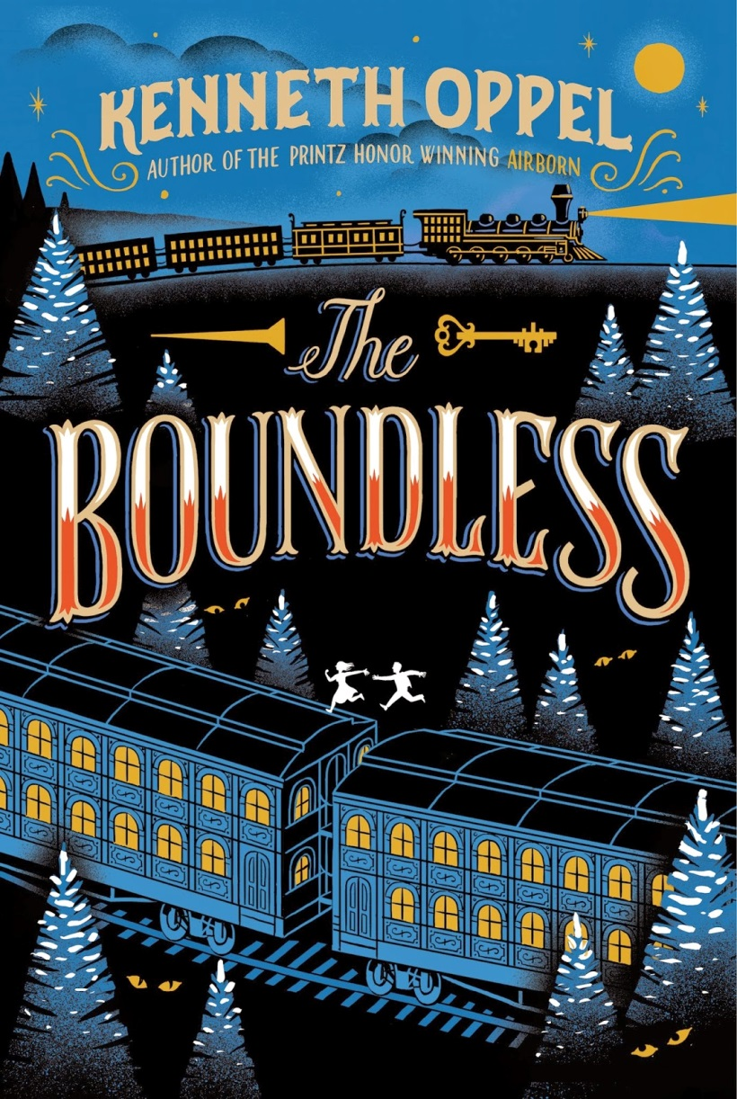
2016
Adventure
Historical Fantasy
This epic Titanic-style Steam Train has a secret treasure hidden in the funeral car behind the locomotive. At the very back of the train is young William and he has the only key to the treasure. Who can he trust with this secret? Will he get to the front of the train before the brakemen catch him?

Slide 10
Spirit Animal Fiction
Aboriginal History
5 year old Red Wolf happens to howl back one night to the call of an orphaned red wolf pup, Crooked Ear. It forges a lifelong bond between them. When Red Wolf is sent to residential school, Crooked Ear cannot follow and must try to find his own way into wolf society. Can either Wolf find love and acceptance in a hostile world?
2016

Slide 11
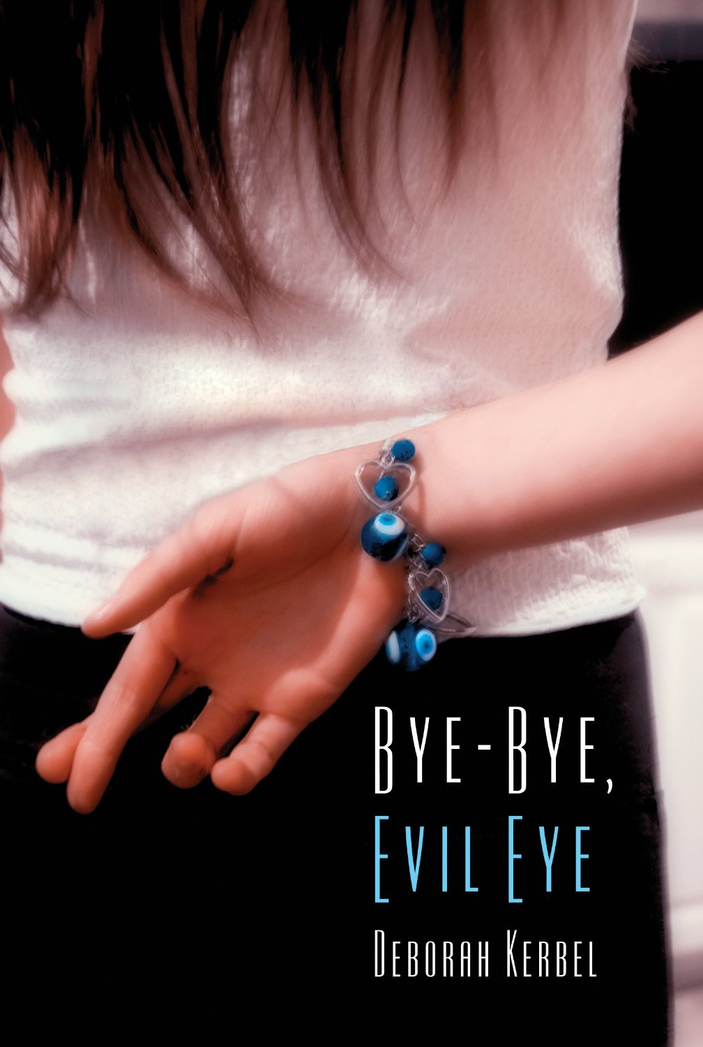
2016
Romance, Suspense
Daniella and her friend Kat visit Greece for three weeks and Dani thinks it's the perfect opportunity to find a boyfriend for Kat. That is until Dani is stricken by the evil eye and her life becomes a string of bad luck. Only Kat's superstitious mother Mrs. P. can help her - but will the cure actually work?
Gone Girl for Tweens

Slide 12
2016
Armchair Travel
Destination: Palestine
If Claire could speak, she would tell you about the time she was stuck in the tiny home of a little Palestinian boy whose house was taken over by 2 Israeli soldiers. But she’s a cat and she only cares about trying to stay alive in the middle of a war zone.
Be careful what you wish for

Slide 13
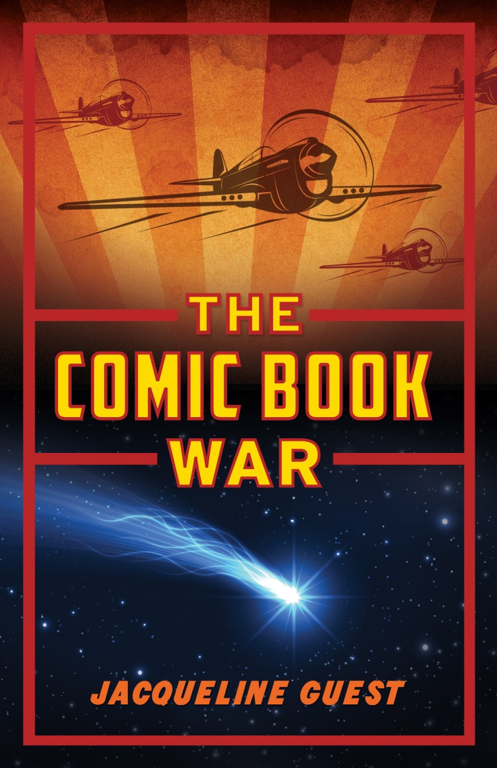
2016
World War II
Robert finds a meteorite and suddenly begins to notice some strange coincidences: when he holds it, great things happen! Since his 3 brothers are fighting WWII, maybe he can use it to keep them safe. Although right now he’s only really worried about finding the cash to buy his favorite comic books.

Slide 14
2016
Humour, Comedy
Diary style
Arthur Bean has an ambition to become a famous author. When the school announces a writing contest, he KNOWS he will win, he thinks he’s that good! And when his secret crush Kennedy, turns out to be his writing partner, things just couldn’t be better. Or could they?
Laugh out loud funny

Slide 15
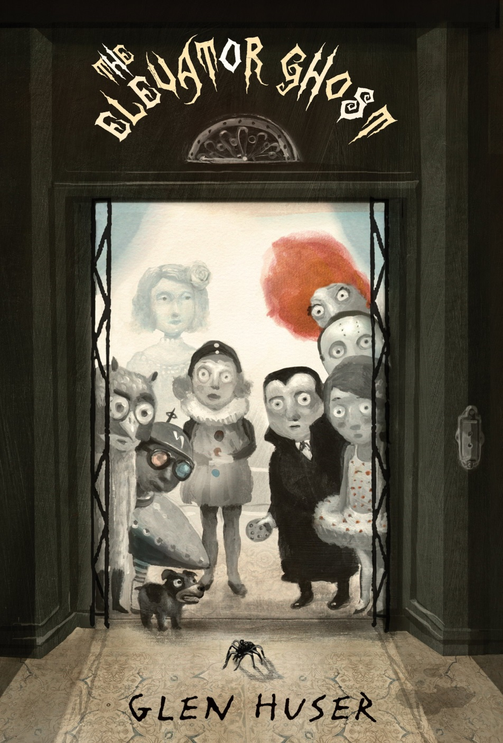
Ghost Story
Read it out loud!
Mrs. Carolina Gibble isn’t your average babysitter. She can solve any problem with storytime and a snack. As long as you don’t mind her pet tarantula and aren’t afraid of ghosts!
Like a spooky Mary Poppins
2016

Slide 16
2016
1st time a Graphic Novel is on the list!
Gaming
Anda lives a super hero’s life in the online game Coarsegold. But when she discovers that some other players are not treated fairly in real life, she’s ready to help them. Until everything goes horribly wrong….

Slide 17
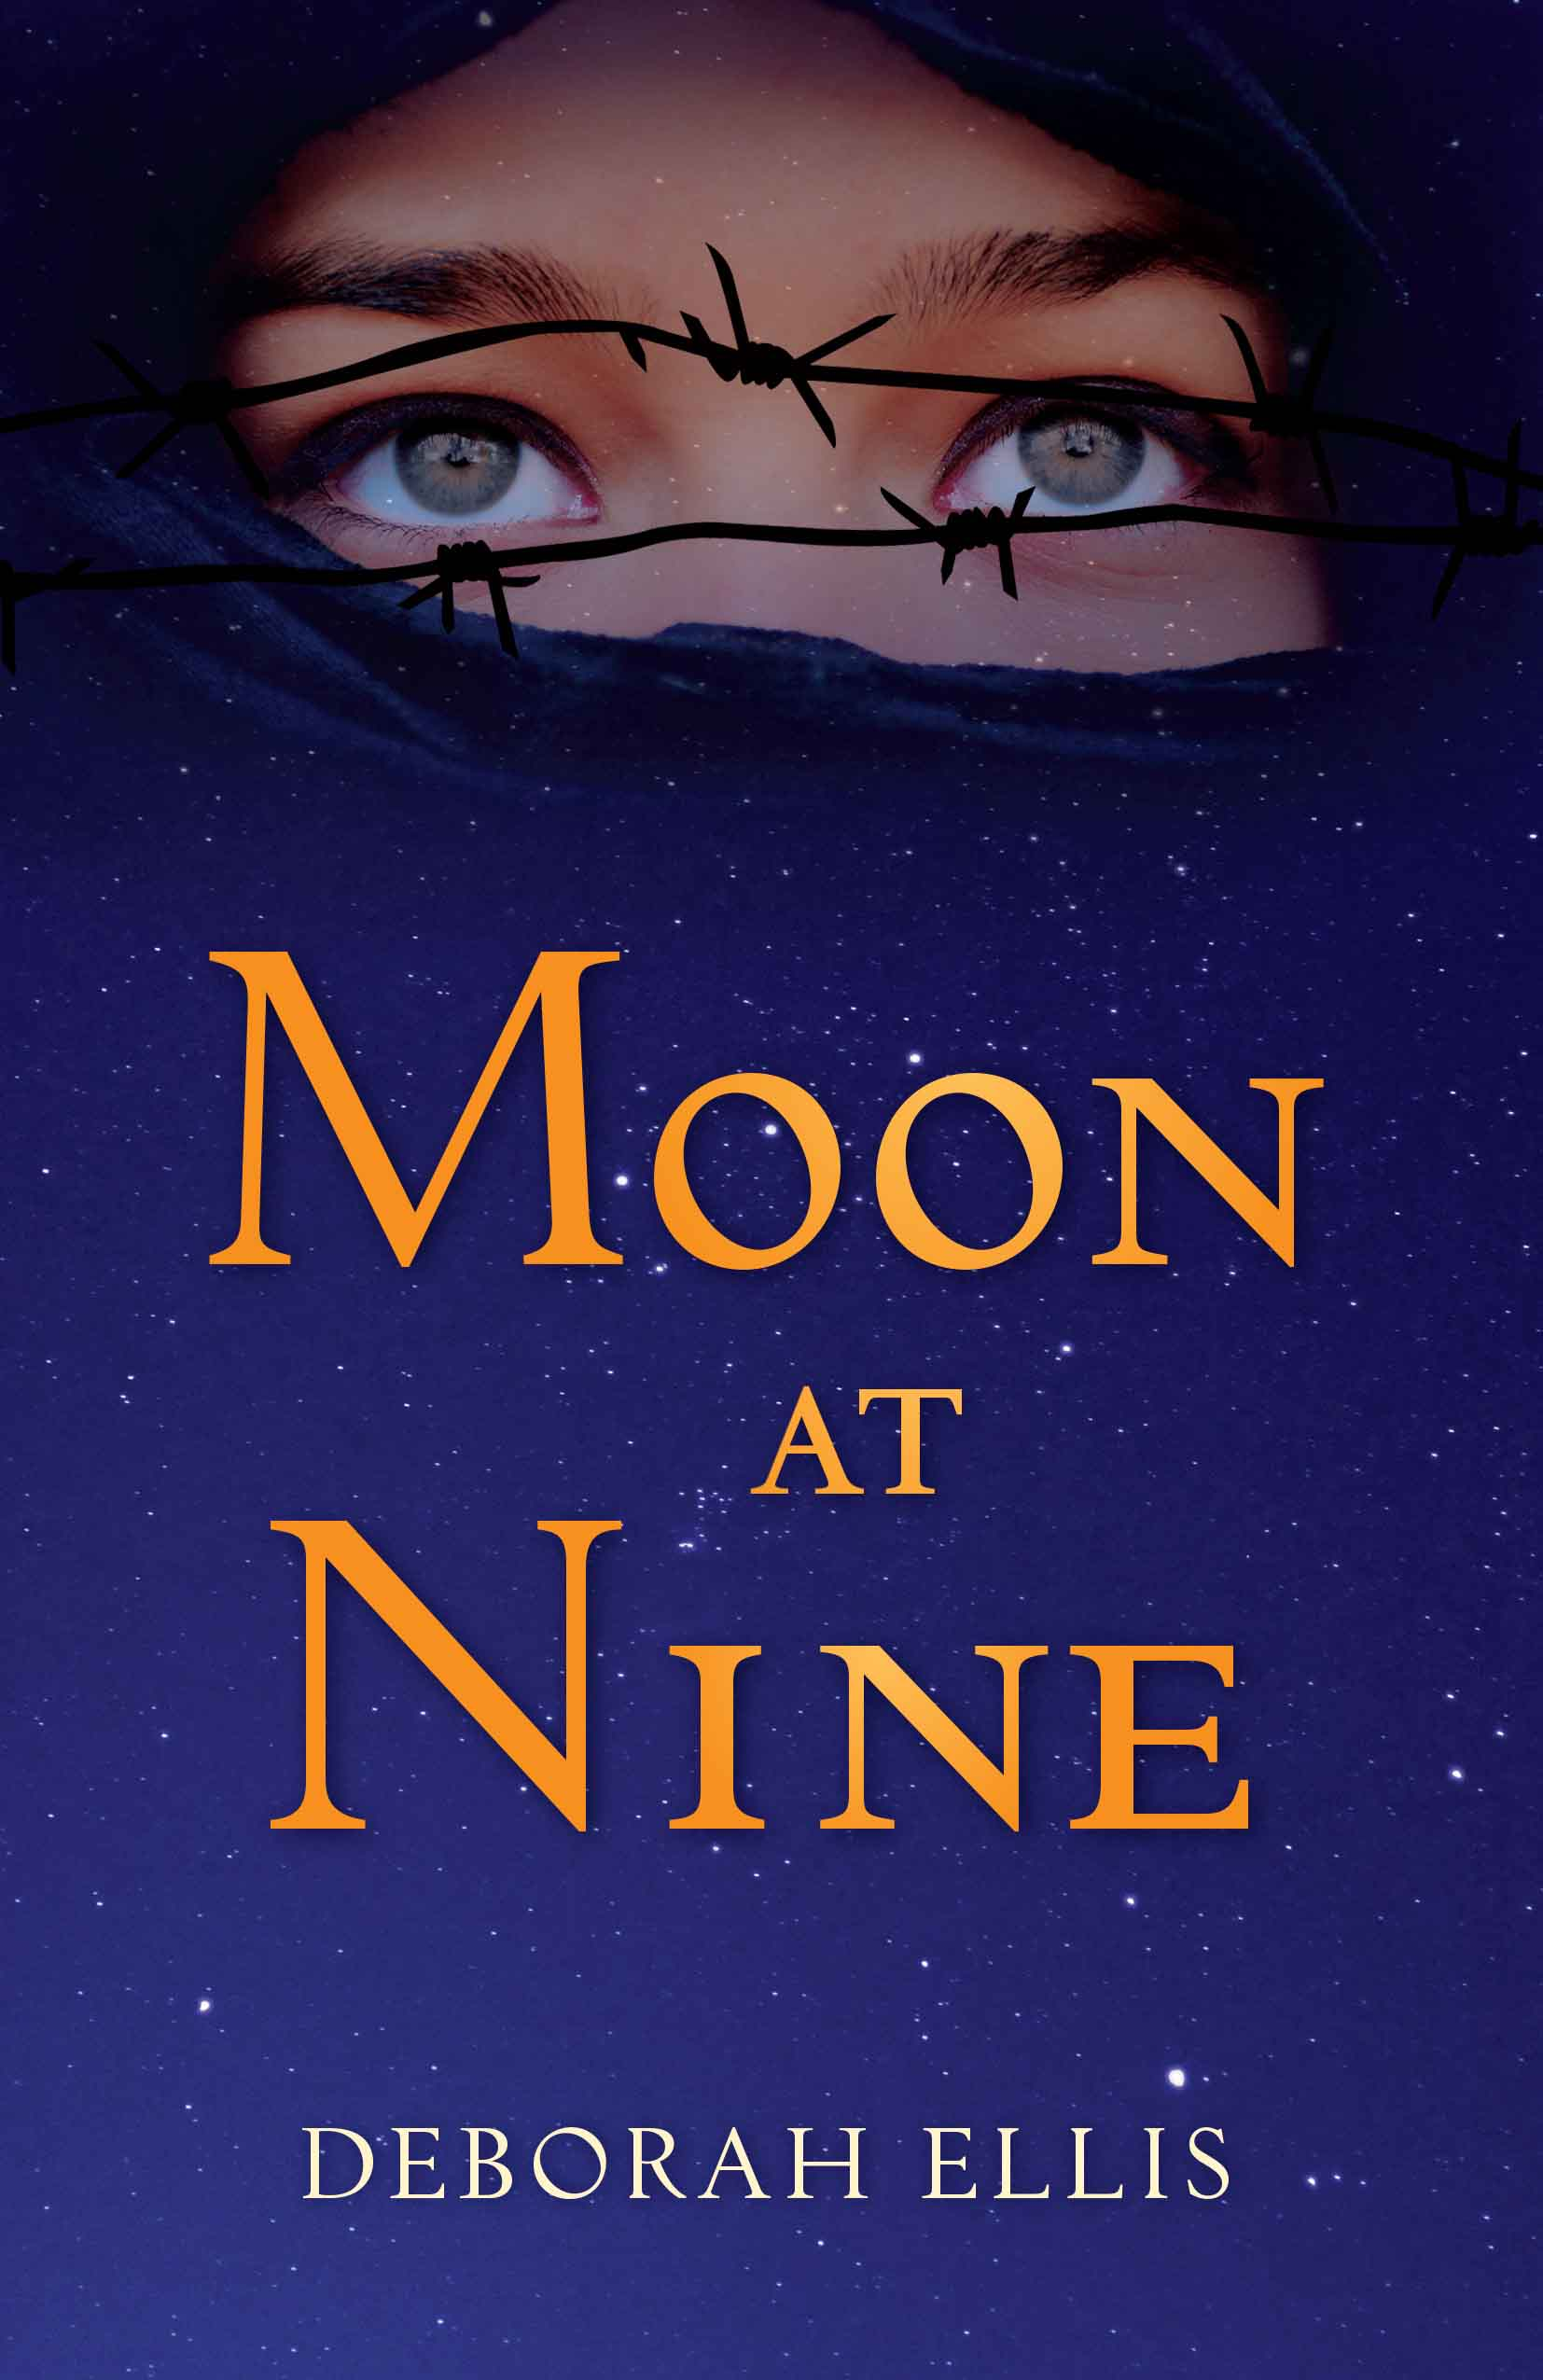
2016
Armchair Travel
Destination: Iran
Farrin is a keeper of secrets. If she reveals her parents' political opinions to anyone at school, it will send her whole family to jail. If she reveals that she is in love with her female classmate, Sadira, she could be put to death.
Based on a true story.

Slide 18
2016
Gothic Thriller
Orphans Molly and Kip find work in Cedar Hollow where no other villager will go. Rumour has it that the tree growing through the Windsor’s mansion is capable of fulfilling anyone’s deepest wishes. So why won’t anyone work there? And what are the Windsors hiding in the secret room?
If you liked: The Legend of Sleepy Hollow, Scary Stories to tell in the Dark.

Slide 19
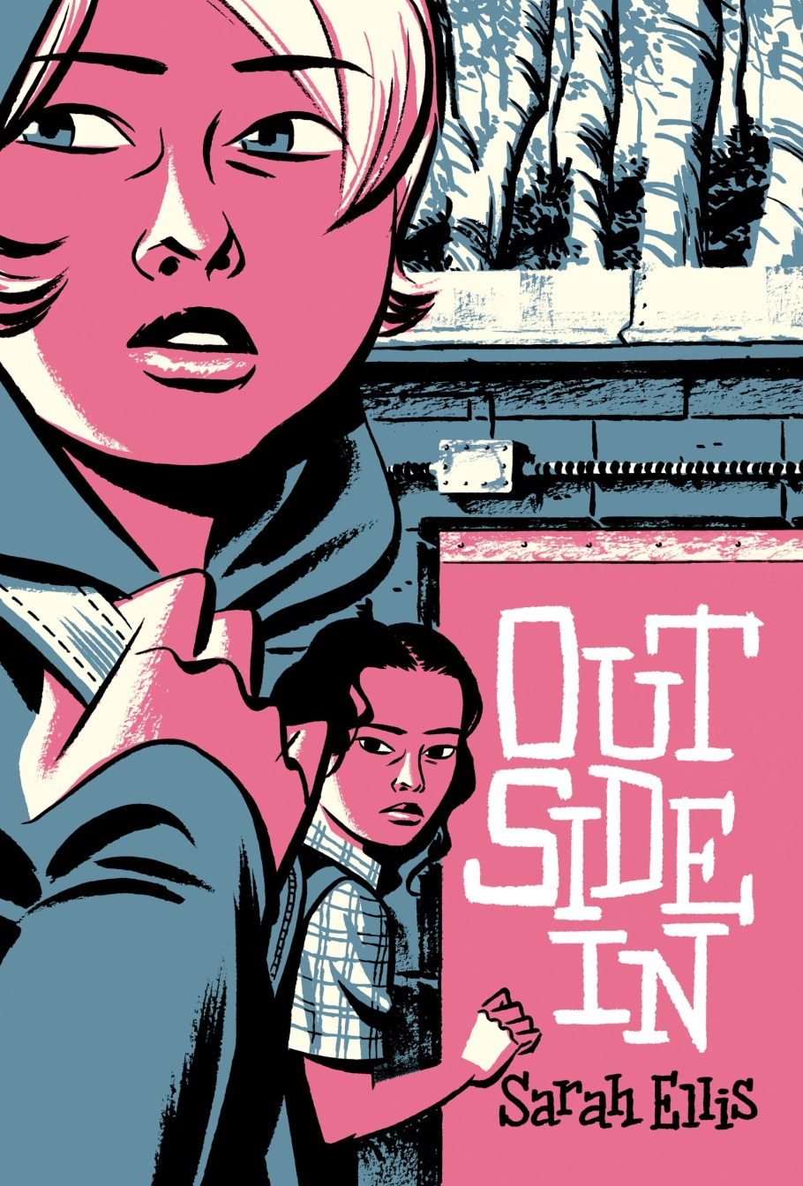
2016
Modern, Realistic
When Lynn gets rescued from choking by a total stranger, she is determined to try and find her savior. As it turns out, her savior is an Underlander named Blossom living off the grid and outside of “citizen” society. Can two girls living opposite lives really become friends?
Think outside the box

Slide 20
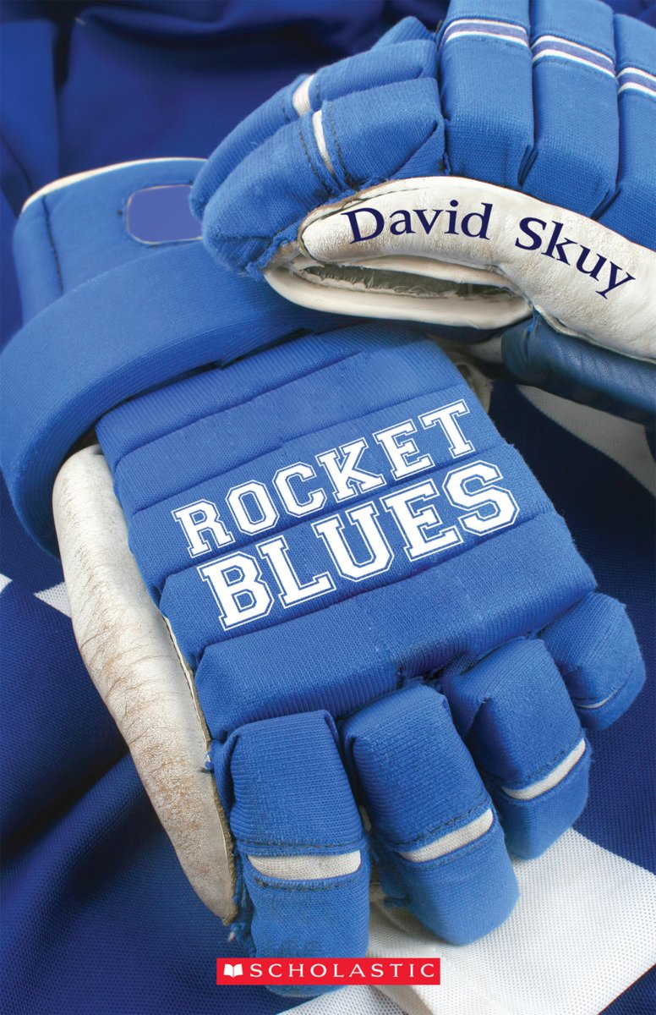
2016
Hockey Fiction
When Bryan, also known as Rocket, gets cut from his longtime AAA team the Huskies, his only choice is to play with the AA team, the Blues. How will he make it through the year when his new teammates play can barely play?
If you liked: Home Ice Advantage, Undergrounders.

Slide 21
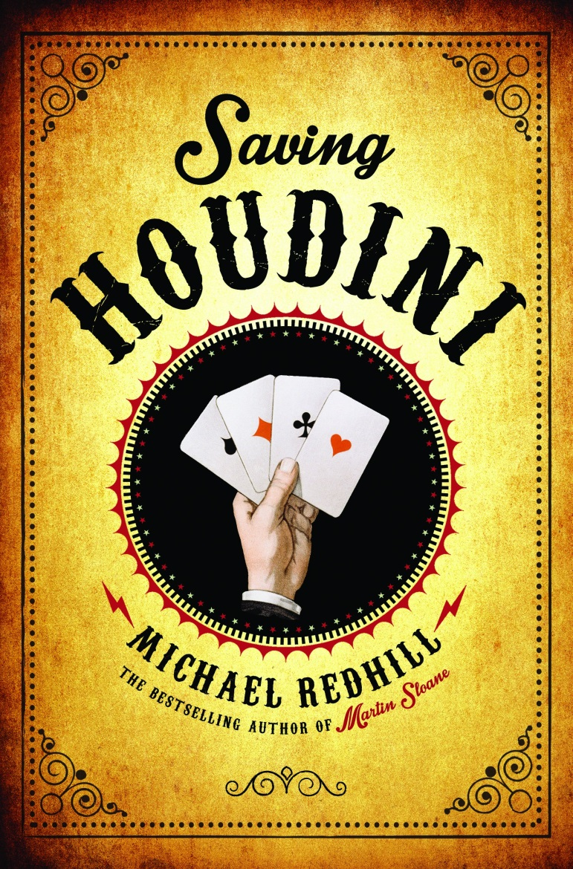
2016
Time Travel Adventure
Magic
Dash gets accidentally transported into 1926 by an illusion called the Magic Soap Bubble. His only hope is to try and find the great Houdini. Maybe he has the power to un-do the Soap Bubble trick and send him back home? Unfortunately the Social Services Society is on his tail and he needs to convince a bully to be his friend.

Slide 22
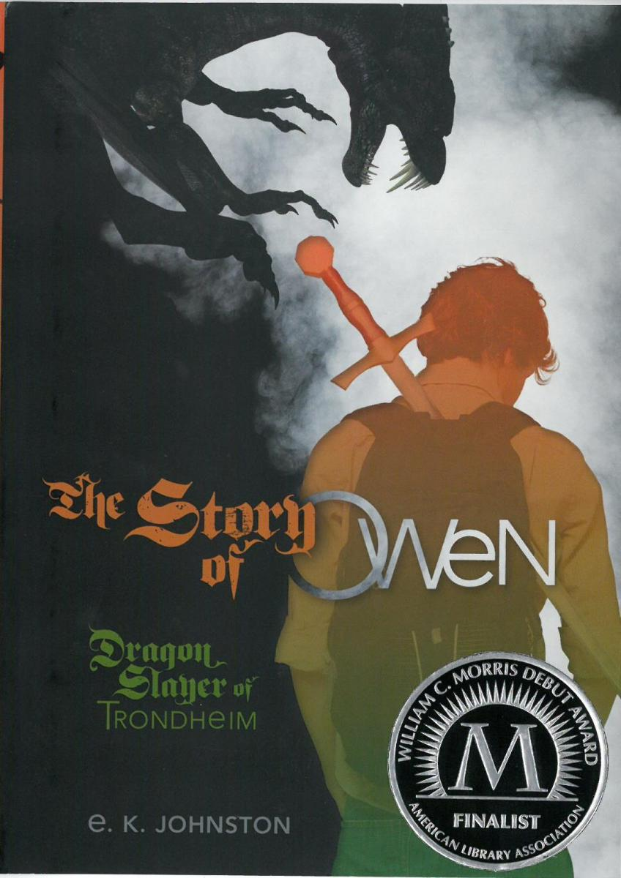
2016
Urban Fantasy
Dragon Battles, Music, Storytelling
Owen is the nephew of the world’s most famous dragon slayer, Lottie Thorskard. But after her career ending accident, the family moves to small town Ontario where Owen’s family’s fame makes it hard for him to fit in. Siobhan is recruited to be his tutor and his friend, even thought he really wants her to be his bard.

Slide 23
2016
Armchair Travel
Destination: Kenya
Muchoki and Jata are normal African children when their father is suddenly killed in a political uprising. Now, living in a refugee camp, and with their Mother’s health deteriorating, their only hope is to walk hundreds of miles to find their last remaining family and get help.

Slide 24
2016
Zombie Fiction
Mystery, Humour
When Imre, a very strange new student, arrives in small town Ontario, Bob is repulsed. Not only is Imre creepy, he’s dead! And to make matters worse, his best friend Evil-O (Olive spelled backwards) instantly begins to defend Imre and accuses Bob of being “anti-zombie”. Are you serious?

Slide 25
World War I
Adventure, History
In small town Saskatchewan, Edward’s uncle likes to build airplanes in the barn. Curious, Edward begs him to teach him how to fly. But the technology is very new and crashes are common. How will he convince his parents that being a pilot and joining the Royal Air Force is his lifelong dream?

Slide 26
2016 MYRCA
Voting begins on March 21st until April 13th, 2016
Read 3, vote once
Read 6, vote twice
Read 15 or more, vote three times!
All nominated books are either written by a Canadian or an author currently living in Canada.
Teachers: follow us on Twitter @MyrcAward for all the latest news.

