Slide 1
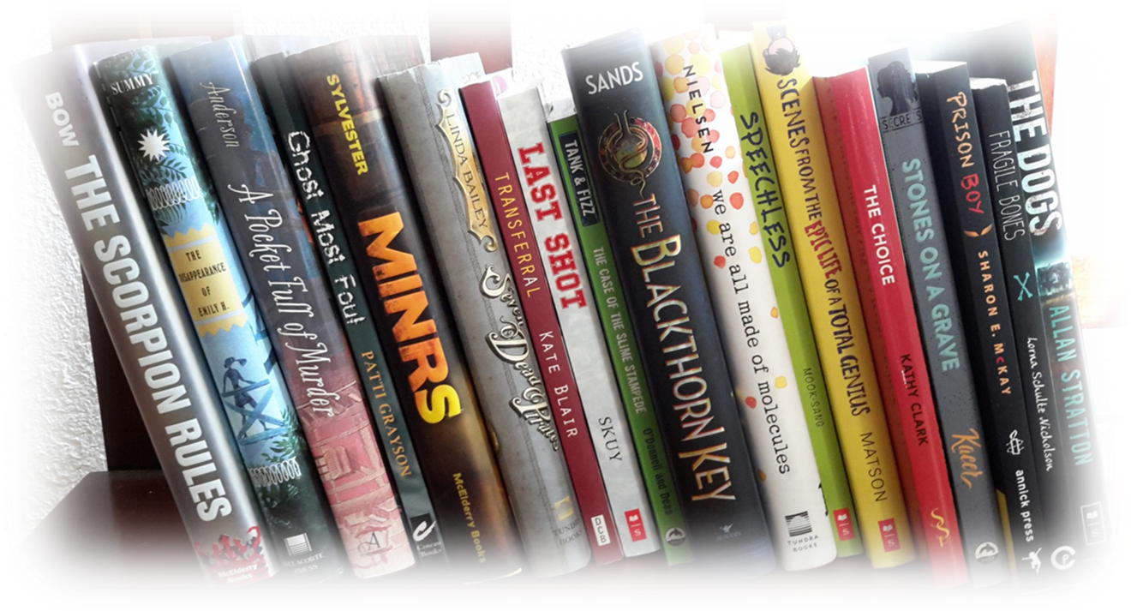
2017
Manitoba
Young readers’ choice
award

Slide 2
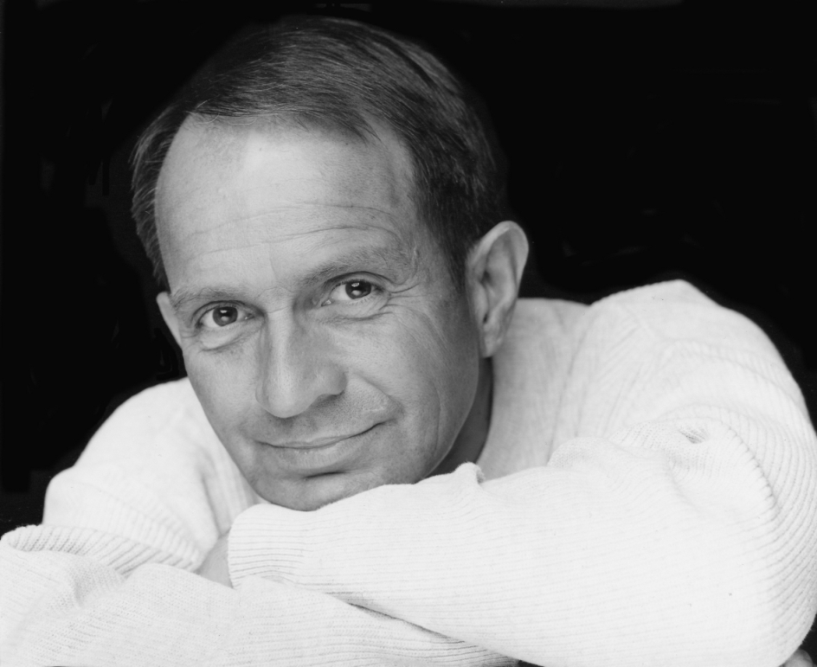
“I am thrilled to have won MYRCA. I will absolutely be available for the award ceremony. Thin Air is one of my very favourite festivals”
September 29th, 2017

Slide 3
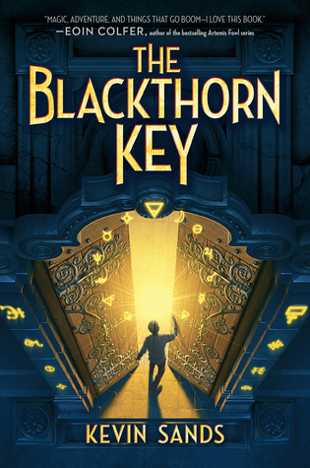
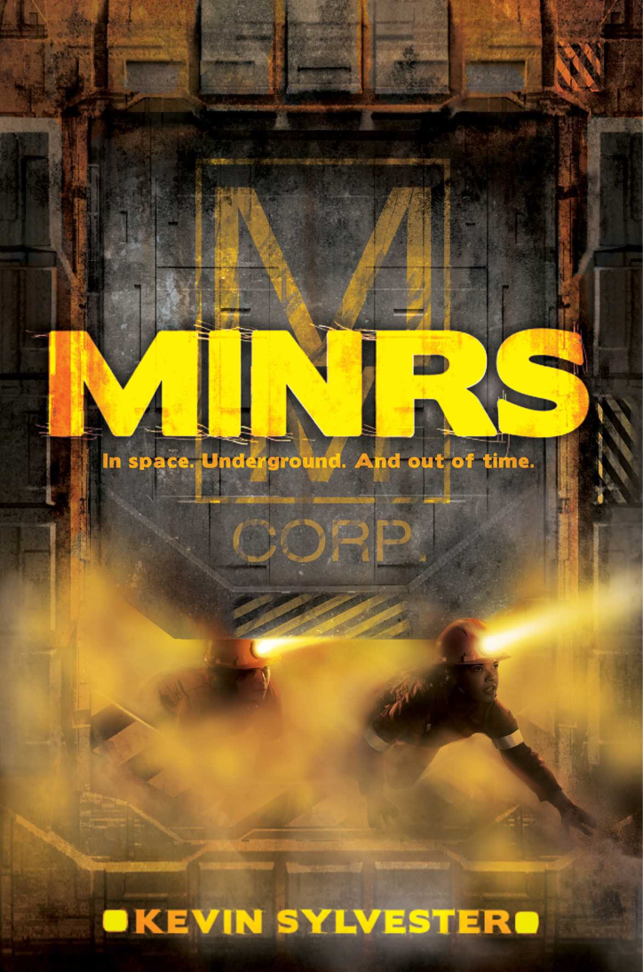
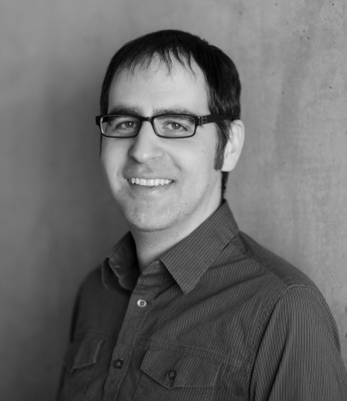
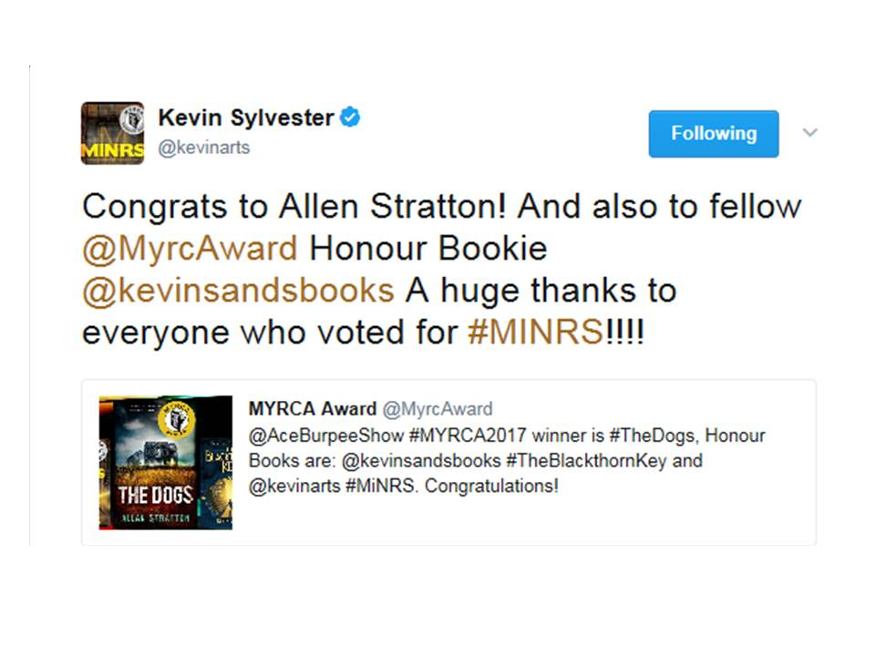
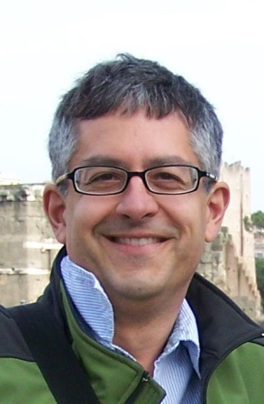
“I'm honoured--no pun intended!”

Slide 4
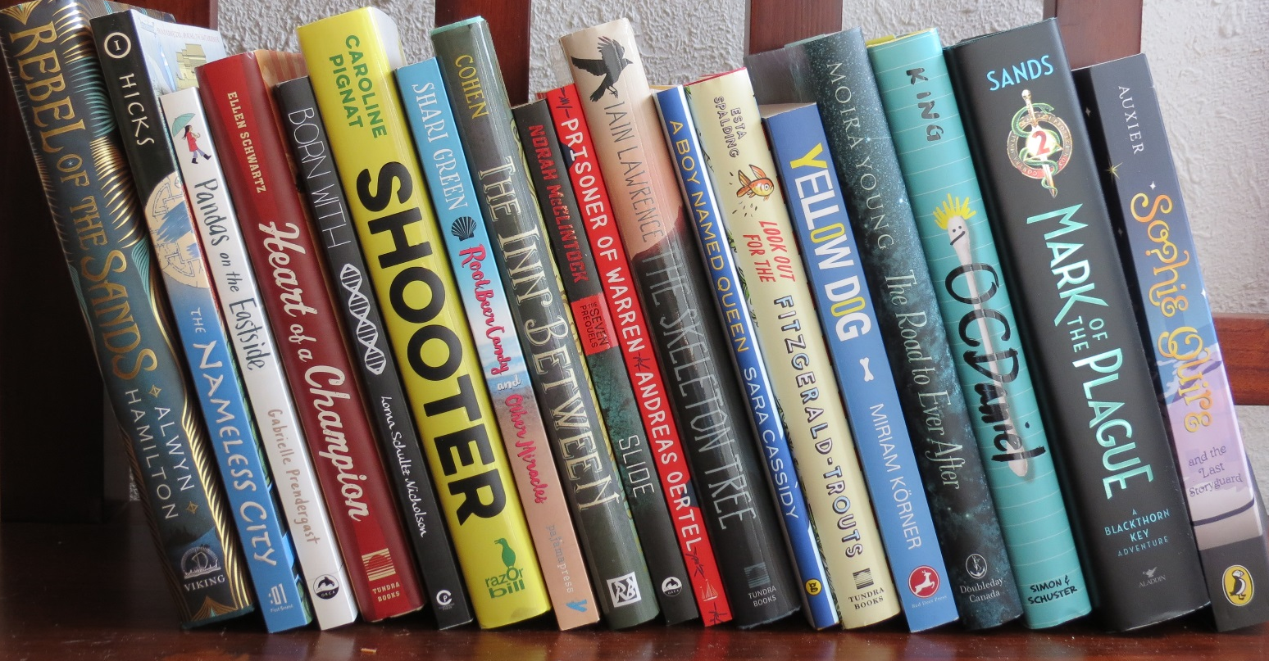
2018
Manitoba
Young readers’ choice
award

Slide 5
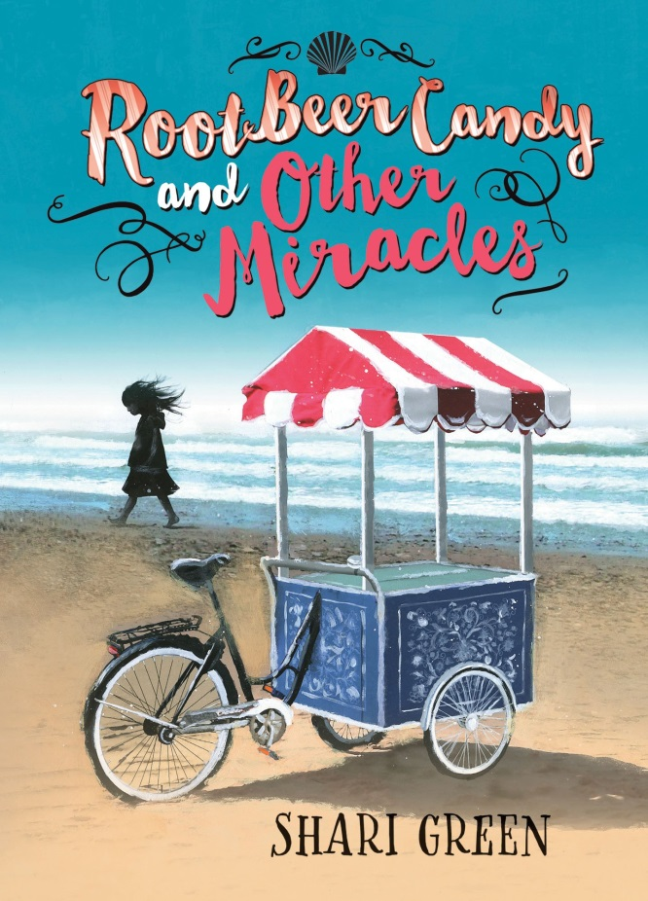
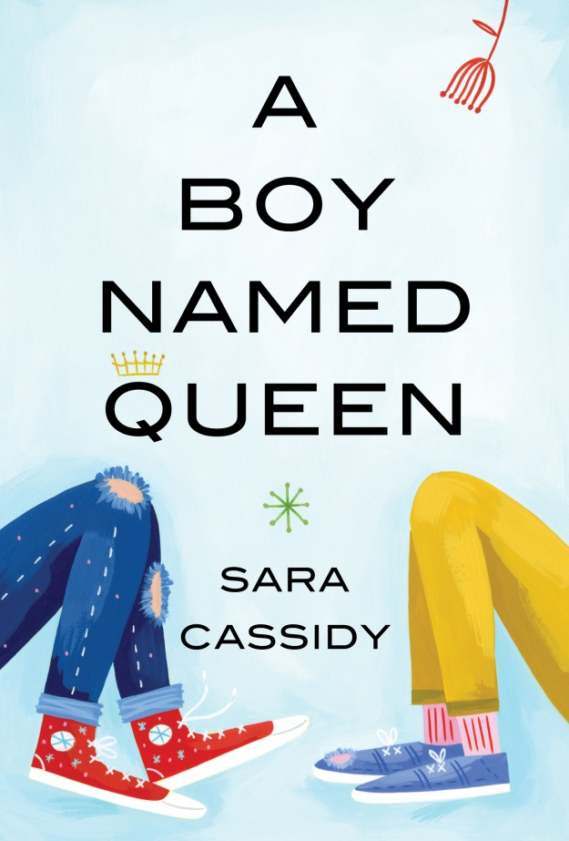
Quick Reads

Slide 6
road Trips

Slide 7
Sports

Slide 8
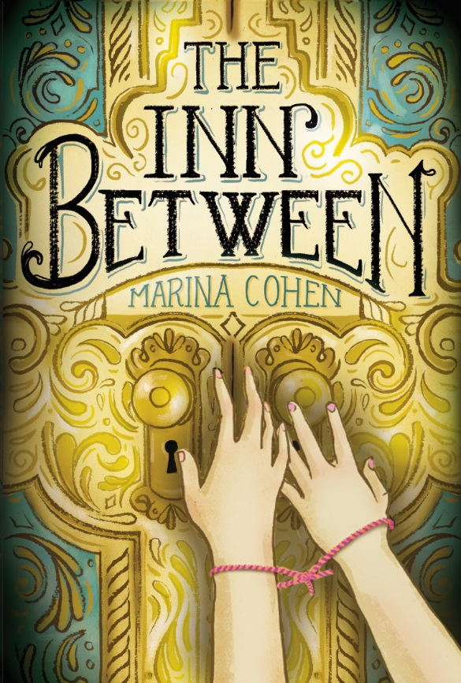
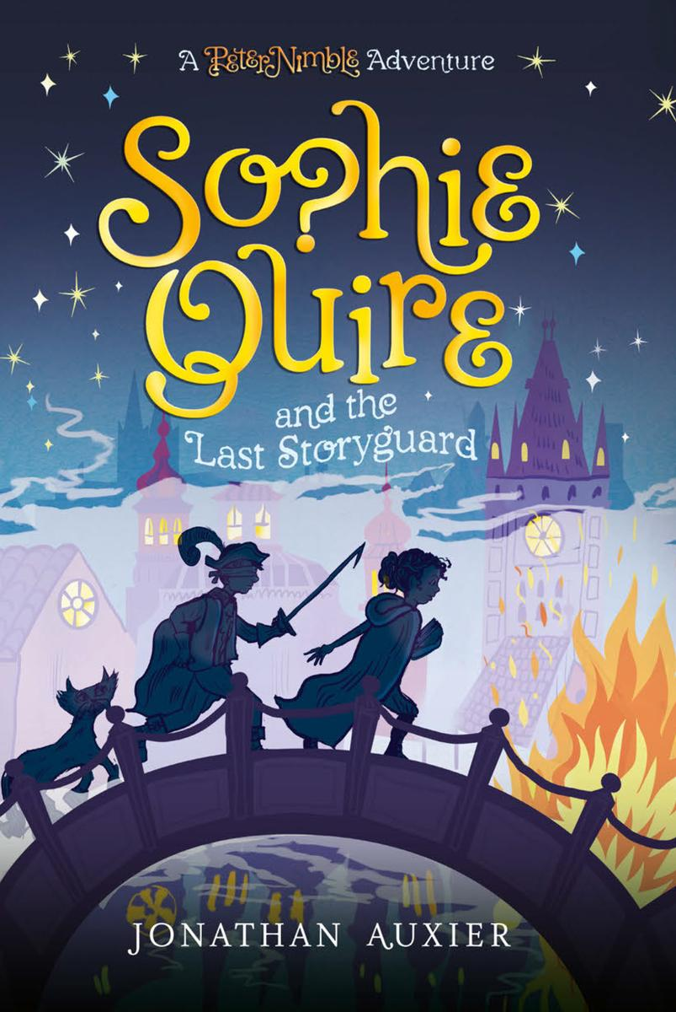
Fantasy

Slide 9
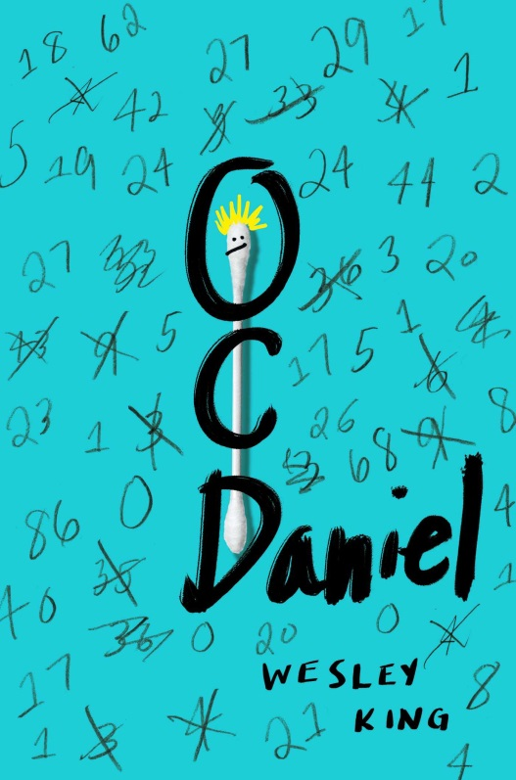
Overcoming Challenges

Slide 10
Adventure

Slide 11
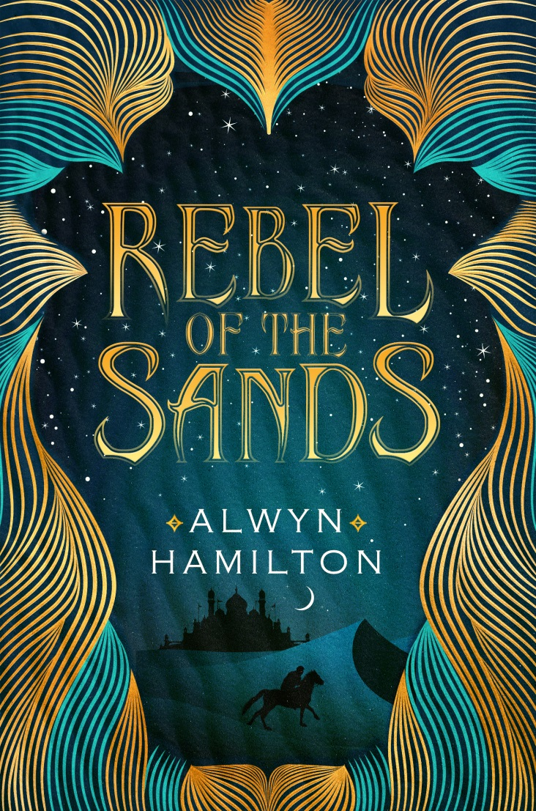
Teen

Slide 12
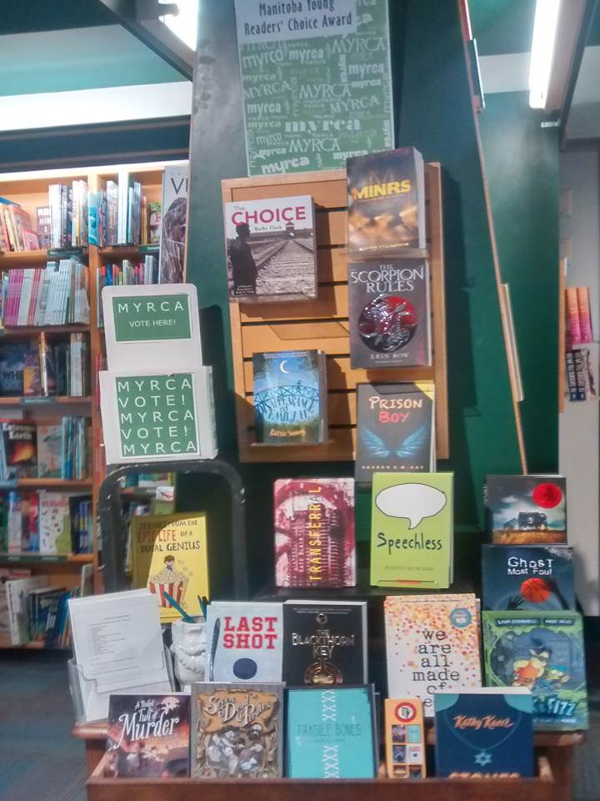
Who can vote:
Any child, resident of Manitoba, in grades 5-8 who have read at least 3 titles from the list.
Read 3 = 1 vote
Read 6+ = 2 votes
Read 15+ = 3 votes
When to vote:
March 19th – April 11th, 2018
Where to vote:
In your school library
or
at Winnipeg Public Library and at McNally Robinson Booksellers

